Slide 1
Time-management in your studies
Tutor*in: Sarah, Ina, Merle
12.11.2025
Notes:
Sarah

Slide 2
Agenda
Your Experiences
Time Management – Our Strategies
Conclusion
Notes:
Sarah

Slide 3
Have you already found good strategies for a good time management in your studies?
Notes:
Sarah
To You: Ask the students about their expectations. If the response is little, try specifying for example exam phase and workload. If not mentioned, ask for differences regarding their secondary school and other comparable experiences.

Slide 4
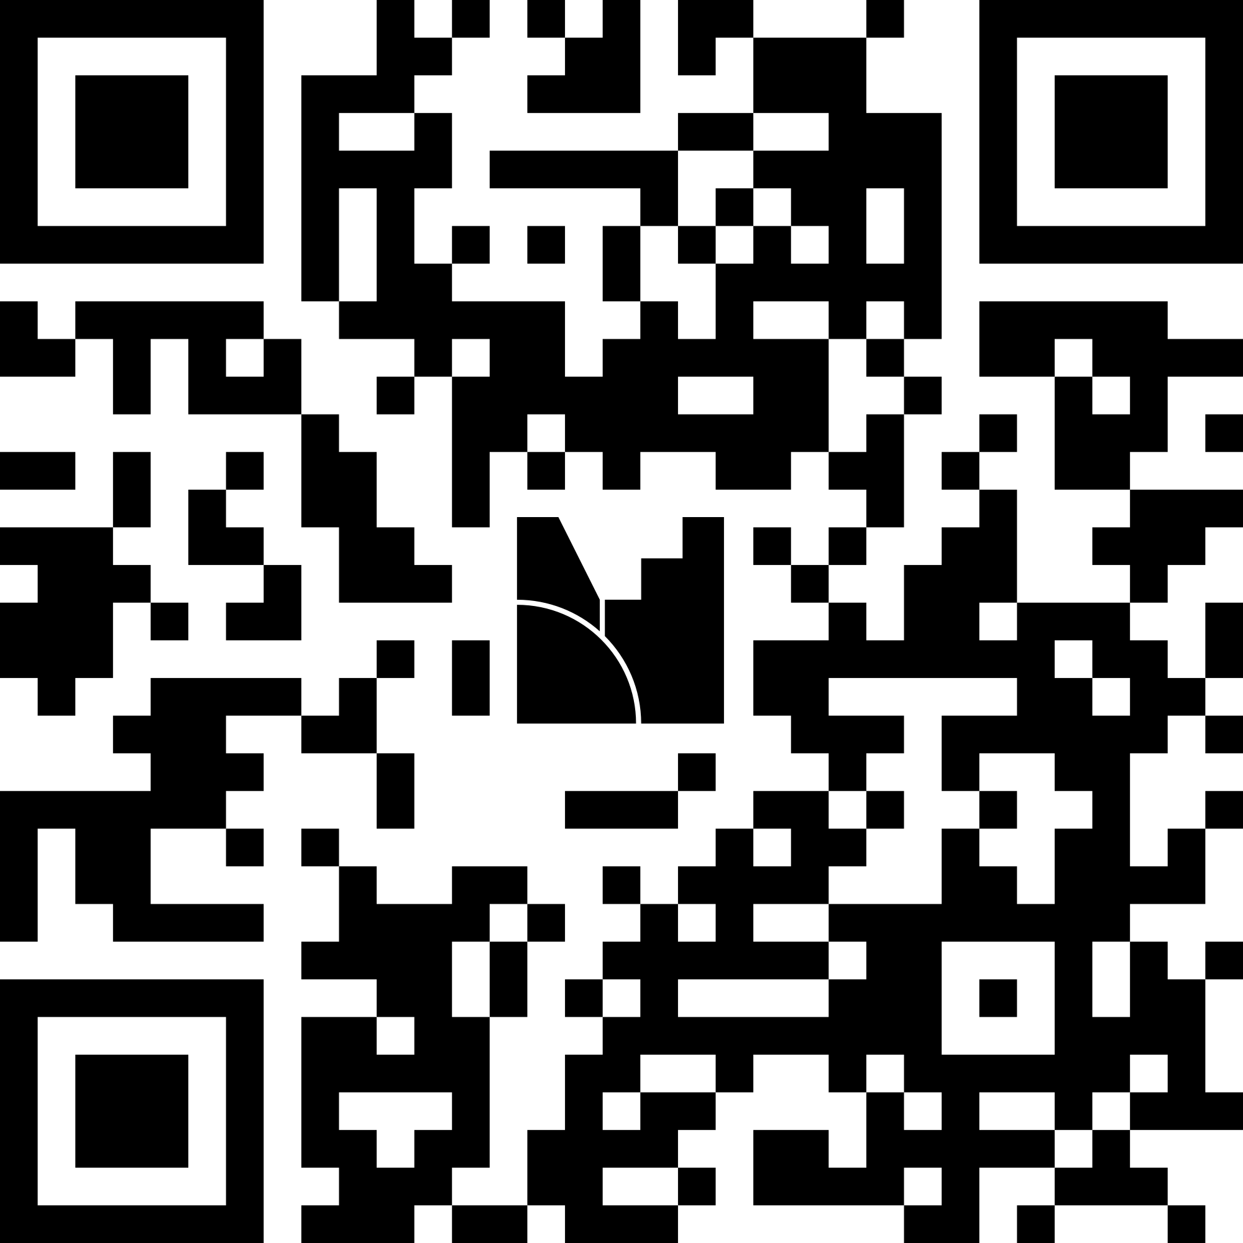
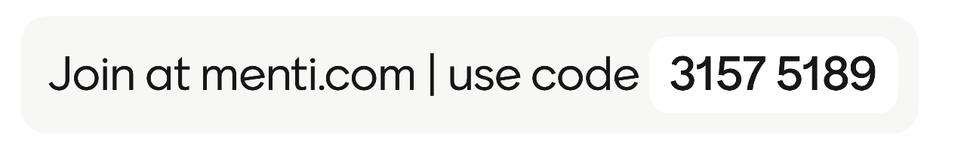
Your time mangement strategies
Notes:
Sarah
Time management

Slide 5
Why time management matters!
Intentional planning and use of time
Use your time better for university, work and private stuff
Reduce your stress level to a minimum
Reaching your academic and personal goals
Notes:
Why time management matters!
Time management allows you to intentional plan and use your time in the Leuphana Semester and we all know the time during the Leuphana semester is flying.
With a working time management you can use your time better for your studies
your work or private stuff.
It can help to reduce your stress , especially in stressful times like the semester finals.
A good working time management is often the key to achieve your goals in academic or personal life

Slide 6
Getting things done (David Allen)
  CAPTURE
  every commitment in your life in a trusted place outside your head (like a software
  program or a piece of paper)
  CLARIFY exactly what each commitment is, the desired
  outcome of fulfilling it, and only
  the very next
  action required
  ORGANIZE reminders of
  these actions in form of a Project List
  REFLECT
on your list on a weekly basis to make sure it’s
clear, current, and complete
EXECUTE on your actions by making intuitive decisions about what to do next, trusting your
system to not let anything fall through the
cracks
Source: https://evernote.com/blog/getting-started-with-gtd-templates/
Notes:
Merle
To the students: 5 principles you can follow in your organizational system. There are also other guidelines. This one is a system that is recommend by the method center.
Capture everything that needs your attention and put it in one place. That can be an notebook, a list or an App
Clarify each commitment, what does it mean and what is the desired outcome. What is the next step to complete your goal
Try then to organize your tasks maybe with a list or a different tool
Reflect your system on a weakly basis. Track your tasks and your progress
Execute your tasks by thinking step by step.

Slide 7
The power of a system
You can be disciplined but still unproductive if you lack a system
A system is a principle according to which something is structured/organized
You have to like the system you follow in order to be efficient!
Notes:
Merle
To the students: You're always smarter afterwards and it's okay to miscalculate a lot of things in the first semester and also in the second semester, it's going to happen .
The most important thing is a systematic approach. This basically just means that you have an order where input and output are clearly regulated and organized.
Whether the system is digital or analog, simple or complicated is up to you. You have to like the system so that it works for you.

Slide 8
Tips & Personal experiences
To-do list
Visualize your time
Time blocking in the calendar
Pomodoro: 25 min work, 5 min break
Networking
Have fun…
Notes:
Ina
To you: Encourage exchange and present and collect ideas and experiences on the topic of self-organization during your studies. Share your own tips as a tutor. We have already started a list here, feel free to add to it. Ask for suggestions from which everyone can choose what works for them (e.g. to the students: We are collecting a few organizational strategies here that you can try out. In the end, you should pick what works for you. You're not stupid or lazy if a popular strategy doesn't work for you. Just try something else again!)
To-do list: simple but effective; tip: a list with everything you can think of and one with the 1-3 most important things you want to do today
Eisenhower matrix: good for prioritizing; depending on whether the task is urgent and/or important, it is treated differently
Time blocking: schedule blocks in the calendar for focused work, organization, but also leisure activities
Pomodoro method: set a timer for 25 minutes and work, then take a 5-minute break (there are also apps that restrict cell phone use during this time); the exact length can of course be changed depending on your own workflow, e.g. some people prefer to work for 50 minutes at a time

Slide 9
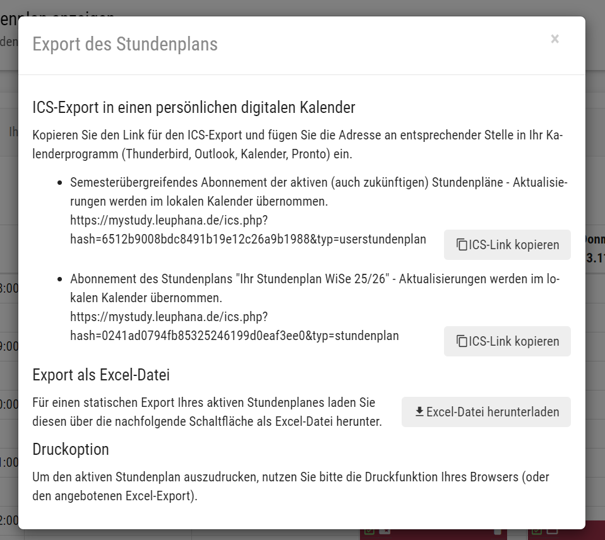
Notes:
Ina
Time management

Slide 10
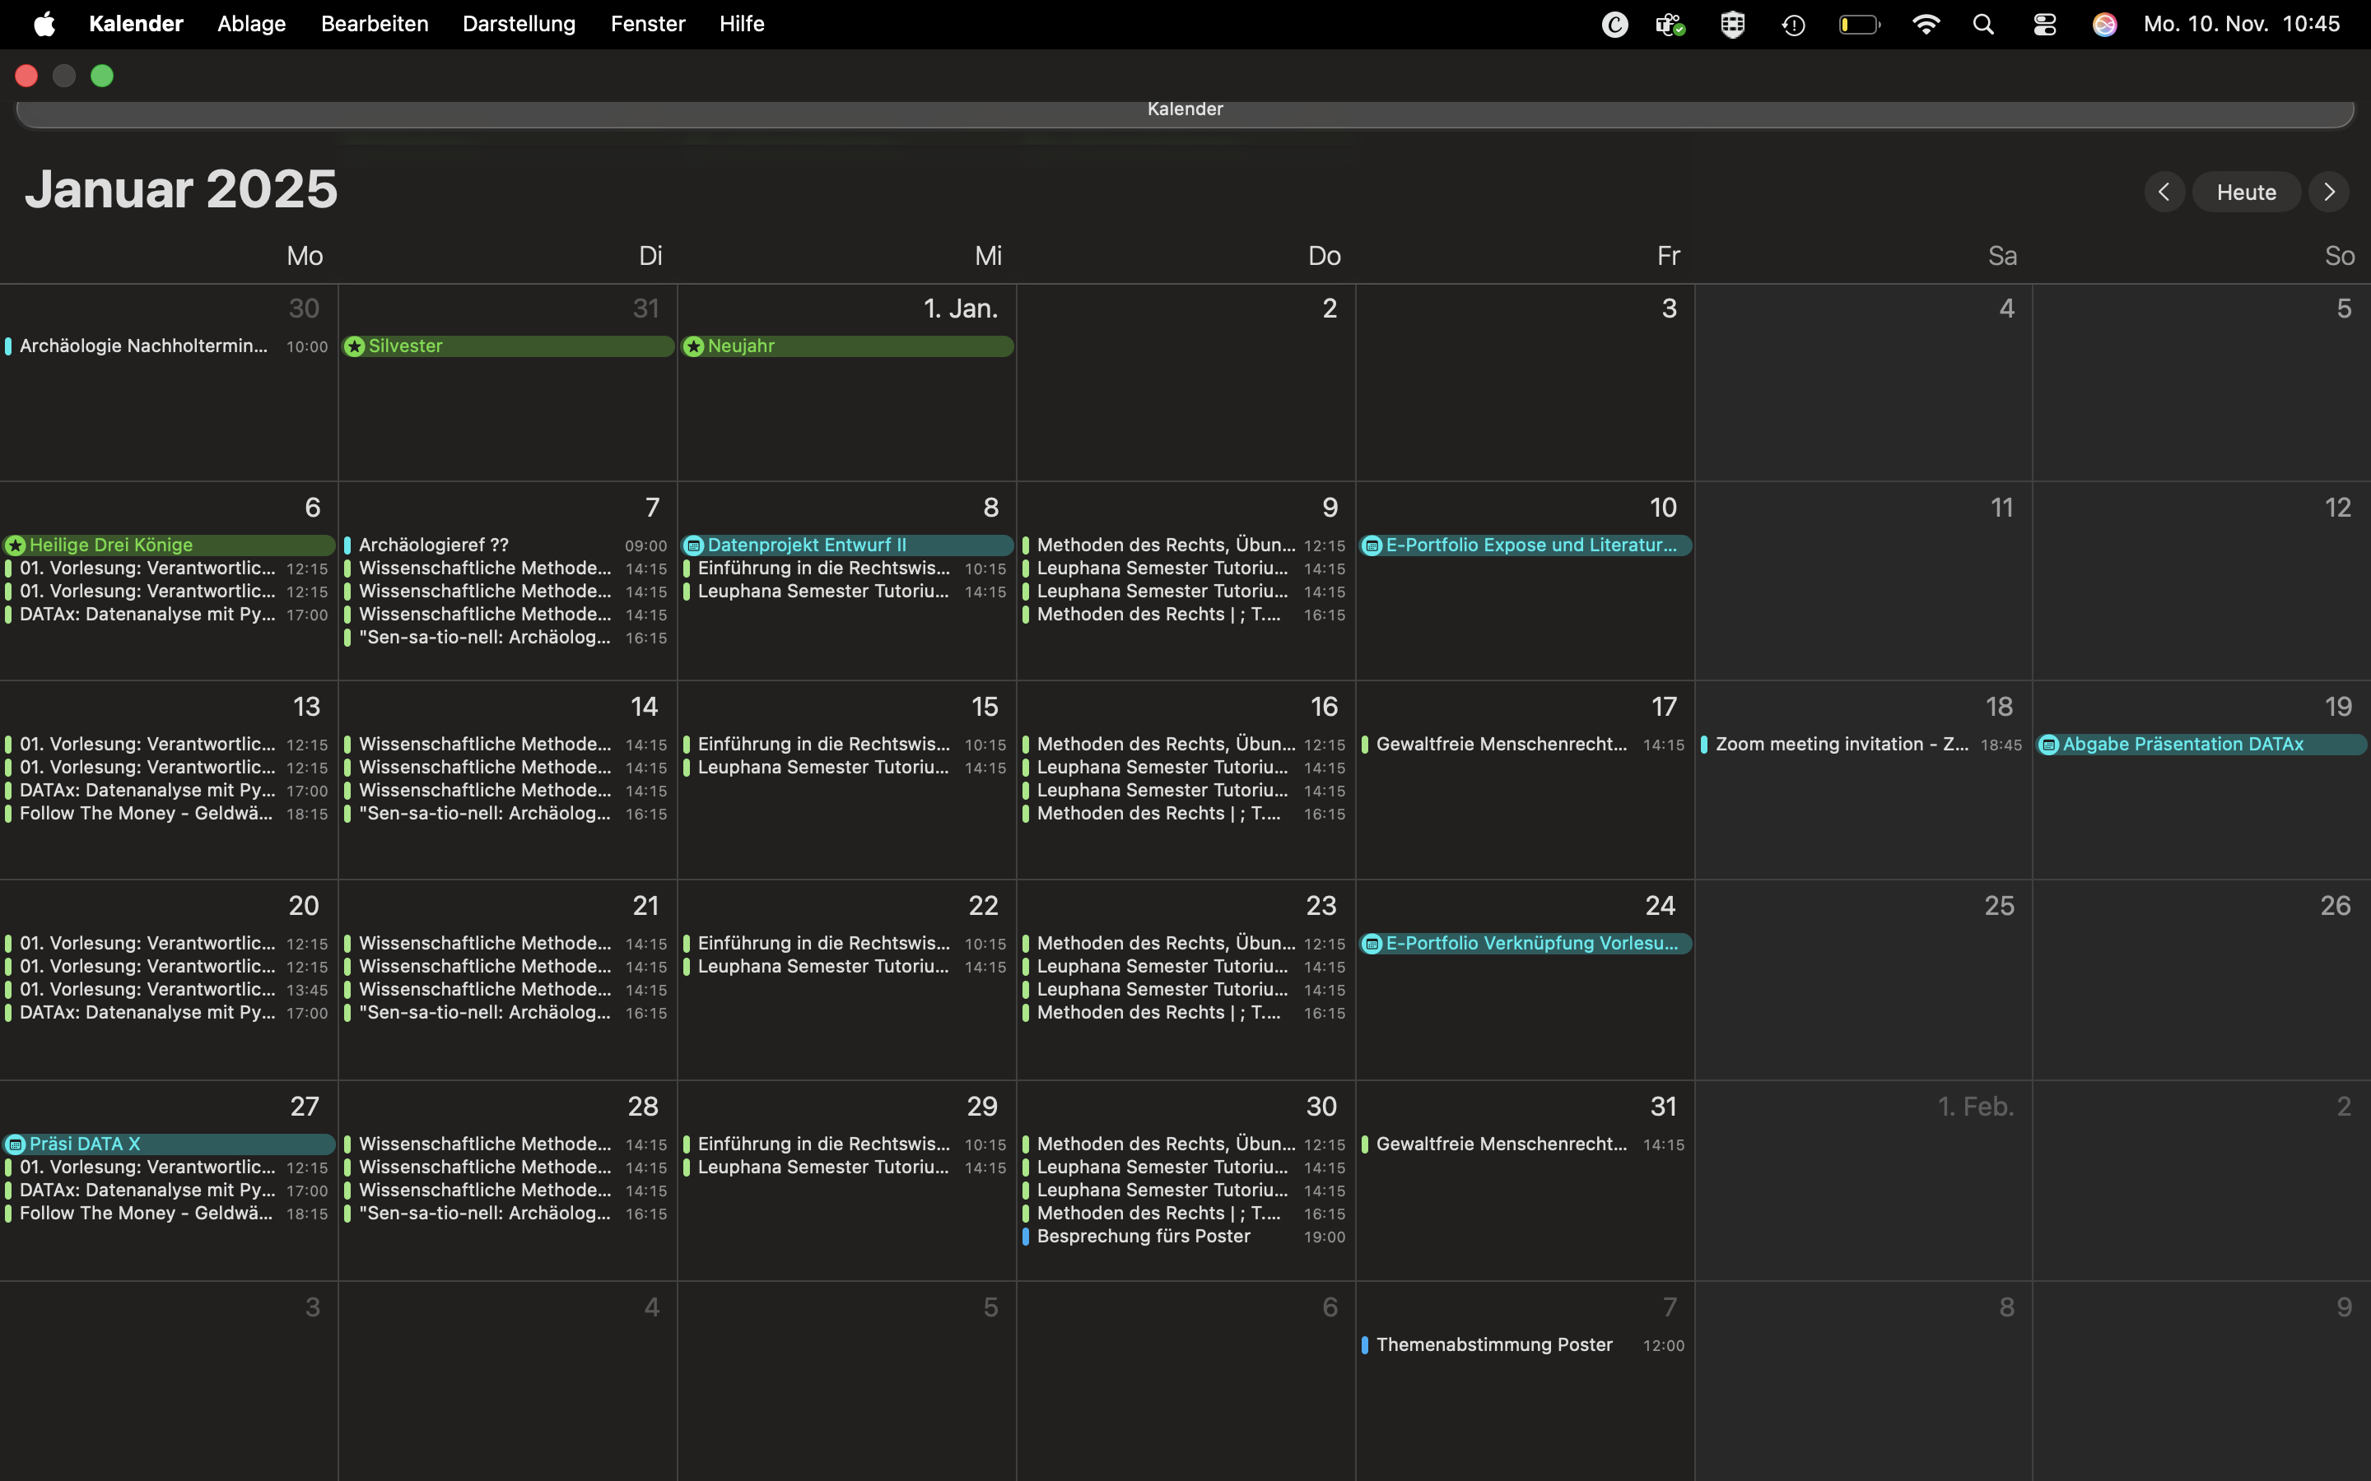
Notes:
Ina
Time management

Slide 11
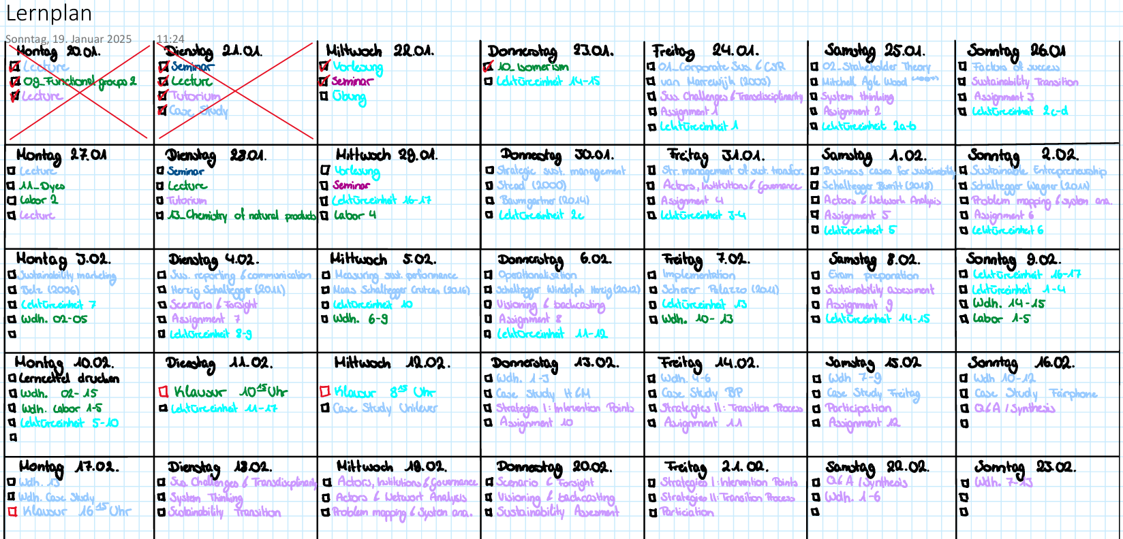
Long-term study plan
Long-term planning can make sence but plan on taking days for rest!!
Notes:
Ina
Time management

Slide 12

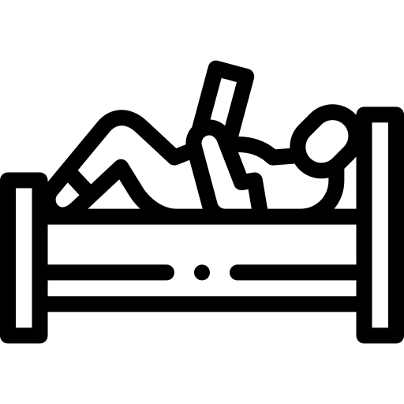
Separation of working and living space
Why it matters
helps your brain switch between focus mode and relax mode
reduces distractions and increases productivity
supports a healthier work–life balance
How to separate, even in small spaces
choose a consistent workspace (desk, corner, specific chair)
avoid studying in bed to protect your sleep and relaxation
Practical tips
go to library, co-working spaces, Klippo, coffee shops
coordinate with roommates (e.g., headphones = “I’m working”)
keep your workspace organized to stay focused
Notes:
Sarah
To you: Encourage exchange and present and collect ideas and experiences on the topic of self-organization during your studies. Share your own tips as a tutor. We have already started a list here, feel free to add to it. Ask for suggestions from which everyone can choose what works for them (e.g. to the students: We are collecting a few organizational strategies here that you can try out. In the end, you should pick what works for you. You're not stupid or lazy if a popular strategy doesn't work for you. Just try something else again!)
To-do list: simple but effective; tip: a list with everything you can think of and one with the 1-3 most important things you want to do today
Eisenhower matrix: good for prioritizing; depending on whether the task is urgent and/or important, it is treated differently
Time blocking: schedule blocks in the calendar for focused work, organization, but also leisure activities
Pomodoro method: set a timer for 25 minutes and work, then take a 5-minute break (there are also apps that restrict cell phone use during this time); the exact length can of course be changed depending on your own workflow, e.g. some people prefer to work for 50 minutes at a time

Slide 13
Most important takeaways!
Time-management is individual
Take your time to find your way into studying, it´s okay to change strategies
Plans have to fit into your life, not your life into the plan
Notes:
Ina

Slide 14
Verwandte Wiki Artikel
Studying: https://sustainabilitymethods.org/index.php/Studying
Pomodoro: https://sustainabilitymethods.org/index.php/Pomodoro
Notion: https://sustainabilitymethods.org/index.php/Notion
Coping with psychological problems: https://sustainabilitymethods.org/index.php/Coping_with_psychological_problems
Notes:
To You: a collection of Wiki articles for further information

Slide 15
Any other questions?
We are 16 experienced students that will help you throughout the Leuphana Semester
Lightning Talks
Help Desk (C25.007)
Wed., HS 1
14:15 – 14:45
Mon. & Fri. 10 – 16;
Wed. 12 - 18
Individual support
Notes:
ari

Slide 16


Notion, the all-in-one workspace
Click here to get the Leuphana Semester Template
Notes:
To the students: System, system - what kind of system? Sounds like a computer program... But it doesn't have to be. And don't worry, you don't have to program anything. If you prefer a physical calendar and are comfortable keeping your to-do's in paper form, then go for it. But there are plenty of advantages to a digital approach and very few disadvantages. We recommend giving the Notion app a try. The program has been flourishing for students for a few years now and combines a writing program, calendar, to-do list and much more. What's more, the app costs nothing for Leuphana students and there is a template that was created especially for the Leuphana semester.

Slide 17
Experiences of previous first-year students
What you can expect
More independence & responsibility
Homesickness - but also the chance to meet great new people and try things out for yourself
Exciting experiences in your studies, work and free time - finding a balance
Initial lack of clarity (Moodle, myStudy etc.) will give with time
It can get stressful at times... but you will master that too
Regular attendance at the tutorial saves a lot of time and effort and makes it easier to get started!
Notes:
To you: Some classic reflections after the first semester are already listed here, add your own if necessary. Try not to frame the points as gloomy prophecies, but rather as situations that could possibly occur. If this is the case, then the first-year students are definitely not alone in this; many others are experiencing this and students before them have done so too. Please emphasize the last point in particular. Of course, you can't prevent some students from no longer coming to the tutorial. But try to convey the value of the tutorials and how they help first-year students to overcome the challenges that await them. We are convinced that the absence from tutorials will lead to considerable additional work and make the start of the semester unnecessarily difficult. Meaningful content is covered that is selected by students themselves.

Slide 18
Mitschreiben, Vor- und Nachbereitung von Vorlesungen
Before the lecture:
Read texts
Download slides (if available)
Write down questions
Take notes during the lecture:
On paper / laptop (e.g. Notion, MS Word) / tablet (e.g. GoodNotes)
Add slides (if slides are available)
Not everything, just the important stuff!
Think for yourself
Follow-up:
If necessary, convert notes into legible form
Clarify gaps in understanding (internet research, ask fellow students)
Create notepads, index cards etc. to prepare for the exam
Make sample exercises (if available)
Tip: Ask yourself questions
Why is this important? What is the main message?
Notes:
To the students: You learn to distinguish the important from the unimportant from facts and information. It can help to ask questions such as “Why is the topic important?” or “What is the main message?”, as this allows you to keep the bigger picture in mind and take notes based on it. It might also help to pay attention to what the professor is focusing on. You learn the most when you really have to use your brain when taking notes, because you formulate things yourself, try to understand, recognize connections,...

Slide 19
Discipline /focus
Learn to say „No“
Self-care
Planning / Structuring / routine
Goal setting
Prioritization
A System
Avoid procrastination
Notes:
To the students: Here are some aspects of effective time management that we find important.

Slide 20
What organizational and time management methods do you use?
Notes:
To you: Encourage the exchange of organizational and time management methods among the students.

